Slide 1
Chapter 15
Writing Large Programs
*
Copyright © 2008 W. W. Norton & Company.
All rights reserved.

Slide 2
Source Files
A C program may be divided among any number of source files.
By convention, source files have the extension .c.
Each source file contains part of the program, primarily definitions of functions and variables.
One source file must contain a function named main, which serves as the starting point for the program.
*
Copyright © 2008 W. W. Norton & Company.
All rights reserved.

Slide 3
Source Files
Consider the problem of writing a simple calculator program.
The program will evaluate integer expressions entered in Reverse Polish notation (RPN), in which operators follow operands.
If the user enters an expression such as
30 5 - 7 *
the program should print its value (175, in this case).
*
Copyright © 2008 W. W. Norton & Company.
All rights reserved.

Slide 4
Source Files
The program will read operands and operators, one by one, using a stack to keep track of intermediate results.
If the program reads a number, it will push the number onto the stack.
If the program reads an operator, it will pop two numbers from the stack, perform the operation, and then push the result back onto the stack.
When the program reaches the end of the user’s input, the value of the expression will be on the stack.
*
Copyright © 2008 W. W. Norton & Company.
All rights reserved.

Slide 5
Source Files
How the expression 30 5 - 7 *: will be evaluated:
Push 30 onto the stack.
Push 5 onto the stack.
Pop the top two numbers from the stack, subtract 5 from 30, giving 25, and then push the result back onto the stack.
Push 7 onto the stack.
Pop the top two numbers from the stack, multiply them, and then push the result back onto the stack.
The stack will now contain 175, the value of the expression.
*
Copyright © 2008 W. W. Norton & Company.
All rights reserved.

Slide 6
Source Files
The program’s main function will contain a loop that performs the following actions:
Read a “token” (a number or an operator).
If the token is a number, push it onto the stack.
If the token is an operator, pop its operands from the stack, perform the operation, and then push the result back onto the stack.
When dividing a program like this one into files, it makes sense to put related functions and variables into the same file.
*
Copyright © 2008 W. W. Norton & Company.
All rights reserved.

Slide 7
Source Files
The function that reads tokens could go into one source file (token.c, say), together with any functions that have to do with tokens.
Stack-related functions such as push, pop, make_empty, is_empty, and is_full could go into a different file, stack.c.
The variables that represent the stack would also go into stack.c.
The main function would go into yet another file, calc.c.
*
Copyright © 2008 W. W. Norton & Company.
All rights reserved.

Slide 8
Source Files
Splitting a program into multiple source files has significant advantages:
Grouping related functions and variables into a single file helps clarify the structure of the program.
Each source file can be compiled separately, which saves time.
Functions are more easily reused in other programs when grouped in separate source files.
*
Copyright © 2008 W. W. Norton & Company.
All rights reserved.

Slide 9
Header Files
Problems that arise when a program is divided into several source files:
How can a function in one file call a function that’s defined in another file?
How can a function access an external variable in another file?
How can two files share the same macro definition or type definition?
The answer lies with the #include directive, which makes it possible to share information among any number of source files.
*
Copyright © 2008 W. W. Norton & Company.
All rights reserved.

Slide 10
Header Files
The #include directive tells the preprocessor to insert the contents of a specified file.
Information to be shared among several source files can be put into such a file.
#include can then be used to bring the file’s contents into each of the source files.
Files that are included in this fashion are called header files (or sometimes include files).
By convention, header files have the extension .h.
*
Copyright © 2008 W. W. Norton & Company.
All rights reserved.

Slide 11
The #include Directive
The #include directive has two primary forms.
The first is used for header files that belong to C’s own library:
#include <filename>
The second is used for all other header files:
#include "filename"
The difference between the two has to do with how the compiler locates the header file.
*
Copyright © 2008 W. W. Norton & Company.
All rights reserved.

Slide 12
The #include Directive
Typical rules for locating header files:
#include <filename>: Search the directory (or directories) in which system header files reside.
#include "filename": Search the current directory, then search the directory (or directories) in which system header files reside.
The places to be searched for header files can usually be altered, often by a command-line option such as -Ipath.
*
Copyright © 2008 W. W. Norton & Company.
All rights reserved.

Slide 13
The #include Directive
Don’t use brackets when including header files that you have written:
#include <myheader.h> /*** WRONG ***/
The preprocessor will probably look for myheader.h where the system header files are kept.
*
Copyright © 2008 W. W. Norton & Company.
All rights reserved.

Slide 14
The #include Directive
The file name in an #include directive may include information that helps locate the file, such as a directory path or drive specifier:
#include "c:\cprogs\utils.h"
/* Windows path */
#include "/cprogs/utils.h"
/* UNIX path */
Although the quotation marks in the #include directive make file names look like string literals, the preprocessor doesn’t treat them that way.
*
Copyright © 2008 W. W. Norton & Company.
All rights reserved.

Slide 15
The #include Directive
It’s usually best not to include path or drive information in #include directives.
Bad examples of Windows #include directives:
#include "d:utils.h"
#include "\cprogs\include\utils.h"
#include "d:\cprogs\include\utils.h"
Better versions:
#include "utils.h"
#include "..\include\utils.h"
*
Copyright © 2008 W. W. Norton & Company.
All rights reserved.

Slide 16
The #include Directive
The #include directive has a third form:
#include tokens
tokens is any sequence of preprocessing tokens.
The preprocessor will scan the tokens and replace any macros that it finds.
After macro replacement, the resulting directive must match one of the other forms of #include.
The advantage of the third kind of #include is that the file name can be defined by a macro rather than being “hard-coded” into the directive itself.
*
Copyright © 2008 W. W. Norton & Company.
All rights reserved.

Slide 17
The #include Directive
Example:
#if defined(IA32)
#define CPU_FILE "ia32.h"
#elif defined(IA64)
#define CPU_FILE "ia64.h"
#elif defined(AMD64)
#define CPU_FILE "amd64.h"
#endif
#include CPU_FILE
*
Copyright © 2008 W. W. Norton & Company.
All rights reserved.

Slide 18
Sharing Macro Definitions and Type Definitions
Most large programs contain macro definitions and type definitions that need to be shared by several source files.
These definitions should go into header files.
*
Copyright © 2008 W. W. Norton & Company.
All rights reserved.

Slide 19
Sharing Macro Definitions and Type Definitions
Suppose that a program uses macros named BOOL, TRUE, and FALSE.
Their definitions can be put in a header file with a name like boolean.h:
#define BOOL int
#define TRUE 1
#define FALSE 0
Any source file that requires these macros will simply contain the line
#include "boolean.h"
*
Copyright © 2008 W. W. Norton & Company.
All rights reserved.

Slide 20
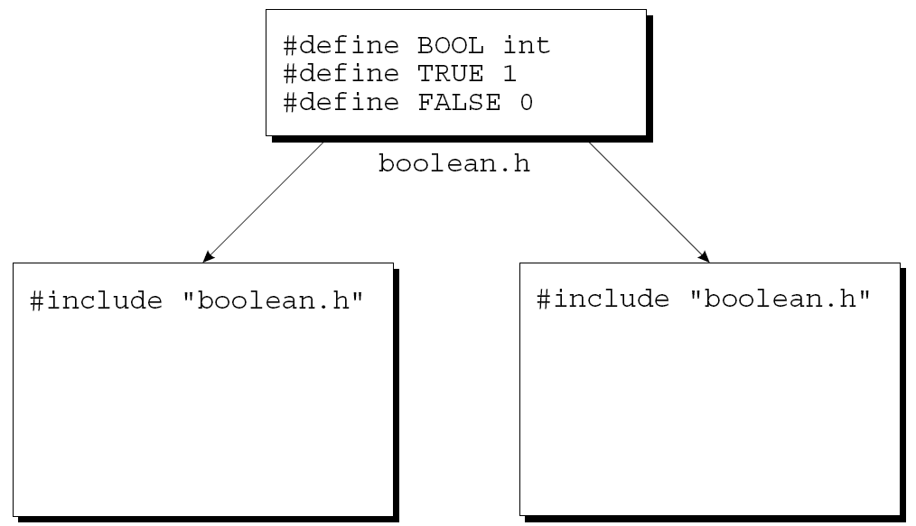
Sharing Macro Definitions and Type Definitions
A program in which two files include boolean.h:
*
Copyright © 2008 W. W. Norton & Company.
All rights reserved.

Slide 21
Sharing Macro Definitions and Type Definitions
Type definitions are also common in header files.
For example, instead of defining a BOOL macro, we might use typedef to create a Bool type.
If we do, the boolean.h file will have the following appearance:
#define TRUE 1
#define FALSE 0
typedef int Bool;
*
Copyright © 2008 W. W. Norton & Company.
All rights reserved.

Slide 22
Sharing Macro Definitions and Type Definitions
Advantages of putting definitions of macros and types in header files:
Saves time. We don’t have to copy the definitions into the source files where they’re needed.
Makes the program easier to modify. Changing the definition of a macro or type requires editing a single header file.
Avoids inconsistencies caused by source files containing different definitions of the same macro or type.
*
Copyright © 2008 W. W. Norton & Company.
All rights reserved.

Slide 23
Sharing Function Prototypes
Suppose that a source file contains a call of a function f that’s defined in another file, foo.c.
Calling f without declaring it first is risky.
The compiler assumes that f’s return type is int.
It also assumes that the number of parameters matches the number of arguments in the call of f.
The arguments themselves are converted automatically by the default argument promotions.
*
Copyright © 2008 W. W. Norton & Company.
All rights reserved.

Slide 24
Sharing Function Prototypes
Declaring f in the file where it’s called solves the problem but can create a maintenance nightmare.
A better solution is to put f’s prototype in a header file (foo.h), then include the header file in all the places where f is called.
We’ll also need to include foo.h in foo.c, enabling the compiler to check that f’s prototype in foo.h matches its definition in foo.c.
*
Copyright © 2008 W. W. Norton & Company.
All rights reserved.

Slide 25
Sharing Function Prototypes
If foo.c contains other functions, most of them should be declared in foo.h.
Functions that are intended for use only within foo.c shouldn’t be declared in a header file, however; to do so would be misleading.
*
Copyright © 2008 W. W. Norton & Company.
All rights reserved.

Slide 26
Sharing Function Prototypes
The RPN calculator example can be used to illustrate the use of function prototypes in header files.
The stack.c file will contain definitions of the make_empty, is_empty, is_full, push, and pop functions.
Prototypes for these functions should go in the stack.h header file:
void make_empty(void);
int is_empty(void);
int is_full(void);
void push(int i);
int pop(void);
*
Copyright © 2008 W. W. Norton & Company.
All rights reserved.

Slide 27
Sharing Function Prototypes
We’ll include stack.h in calc.c to allow the compiler to check any calls of stack functions that appear in the latter file.
We’ll also include stack.h in stack.c so the compiler can verify that the prototypes in stack.h match the definitions in stack.c.
*
Copyright © 2008 W. W. Norton & Company.
All rights reserved.

Slide 28
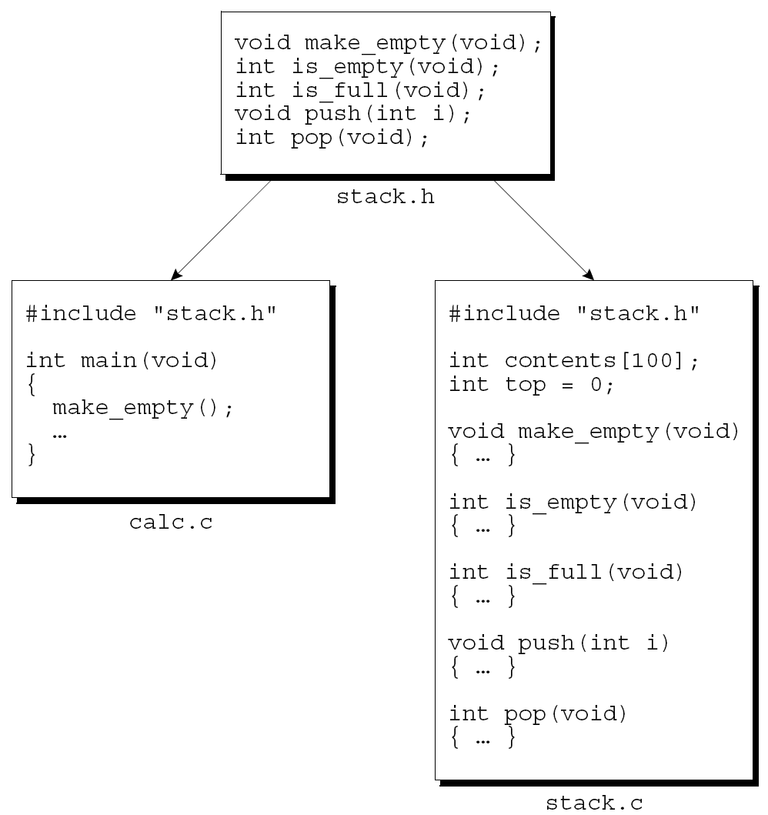
Sharing Function Prototypes
*
Copyright © 2008 W. W. Norton & Company.
All rights reserved.

Slide 29
Sharing Variable Declarations
To share a function among files, we put its definition in one source file, then put declarations in other files that need to call the function.
Sharing an external variable is done in much the same way.
*
Copyright © 2008 W. W. Norton & Company.
All rights reserved.

Slide 30
Sharing Variable Declarations
An example that both declares and defines i (causing the compiler to set aside space):
int i;
The keyword extern is used to declare a variable without defining it:
extern int i;
extern informs the compiler that i is defined elsewhere in the program, so there’s no need to allocate space for it.
*
Copyright © 2008 W. W. Norton & Company.
All rights reserved.

Slide 31
Sharing Variable Declarations
When we use extern in the declaration of an array, we can omit the length of the array:
extern int a[];
Since the compiler doesn’t allocate space for a at this time, there’s no need for it to know a’s length.
*
Copyright © 2008 W. W. Norton & Company.
All rights reserved.

Slide 32
Sharing Variable Declarations
To share a variable i among several source files, we first put a definition of i in one file:
int i;
If i needs to be initialized, the initializer would go here.
The other files will contain declarations of i:
extern int i;
By declaring i in each file, it becomes possible to access and/or modify i within those files.
*
Copyright © 2008 W. W. Norton & Company.
All rights reserved.

Slide 33
Sharing Variable Declarations
When declarations of the same variable appear in different files, the compiler can’t check that the declarations match the variable’s definition.
For example, one file may contain the definition
int i;
while another file contains the declaration
extern long i;
An error of this kind can cause the program to behave unpredictably.
*
Copyright © 2008 W. W. Norton & Company.
All rights reserved.

Slide 34
Sharing Variable Declarations
To avoid inconsistency, declarations of shared variables are usually put in header files.
A source file that needs access to a particular variable can then include the appropriate header file.
In addition, each header file that contains a variable declaration is included in the source file that contains the variable’s definition, enabling the compiler to check that the two match.
*
Copyright © 2008 W. W. Norton & Company.
All rights reserved.

Slide 35
Sharing Variable Declarations
gcc -o m main.c f.c
h.h
int i;
f.c
#include <stdio.h>
#include "h.h"
int f()
{
printf("in f(): i+1 = %d\n", i+1);
}
main.c
#include <stdio.h>
#include "h.h"
main()
{
printf("in main(): i=%d\n", i);
f();
}
*
Copyright © 2008 W. W. Norton & Company.
All rights reserved.

Slide 36
Sharing Variable Declarations
$ gcc -o m main.c f.c
/tmp/ccbPPkHV.o:(.data+0x0): multiple definition of `i'
/tmp/cczVGtRG.o:(.data+0x0): first defined here
collect2: error: ld returned 1 exit status
h.h
int i=8;
f.c
#include <stdio.h>
#include "h.h"
int f()
{
printf("in f(): i+1 = %d\n", i+1);
}
main.c
#include <stdio.h>
#include "h.h"
main()
{
printf("in main(): i=%d\n", i);
f();
}
*
Copyright © 2008 W. W. Norton & Company.
All rights reserved.

Slide 37
Sharing Variable Declarations
$ gcc -o m main.c f.c
h.h
int i; or int i=8;
f.c
#include <stdio.h>
extern int i;
int f()
{
printf("in f(): i+1 = %d\n", i+1);
}
main.c
#include <stdio.h>
#include "h.h"
main()
{
printf("in main(): i=%d\n", i);
f();
}
*
Copyright © 2008 W. W. Norton & Company.
All rights reserved.

Slide 38
Nested Includes
A header file may contain #include directives.
stack.h contains the following prototypes:
int is_empty(void);
int is_full(void);
Since these functions return only 0 or 1, it’s a good idea to declare their return type to be Bool:
Bool is_empty(void);
Bool is_full(void);
We’ll need to include the boolean.h file in stack.h so that the definition of Bool is available when stack.h is compiled.
*
Copyright © 2008 W. W. Norton & Company.
All rights reserved.

Slide 39
Nested Includes
Traditionally, C programmers shun nested includes.
However, the bias against nested includes has largely faded away, in part because nested includes are common practice in C++.
*
Copyright © 2008 W. W. Norton & Company.
All rights reserved.

Slide 40
Protecting Header Files
If a source file includes the same header file twice, compilation errors may result.
This problem is common when header files include other header files.
Suppose that file1.h includes file3.h, file2.h includes file3.h, and prog.c includes both file1.h and file2.h.
*
Copyright © 2008 W. W. Norton & Company.
All rights reserved.

Slide 41
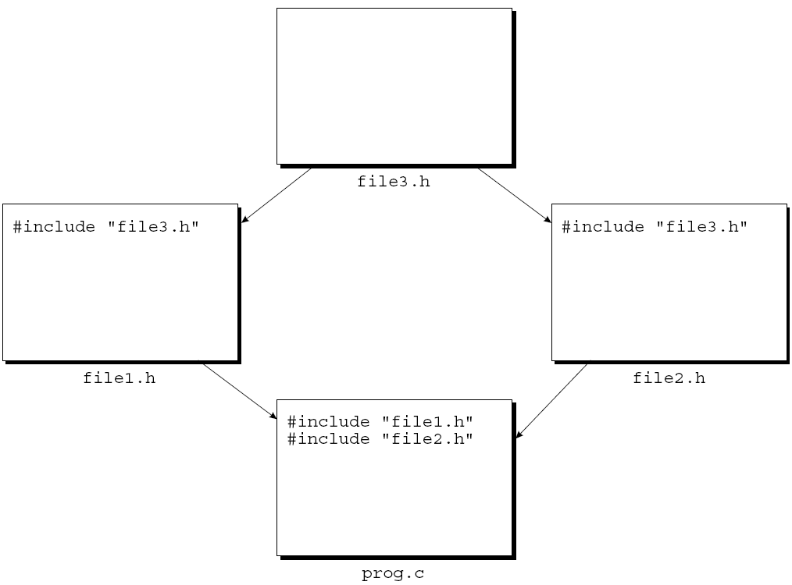
Protecting Header Files
When prog.c is compiled, file3.h will be compiled twice.
*
Copyright © 2008 W. W. Norton & Company.
All rights reserved.

Slide 42
Protecting Header Files
Including the same header file twice doesn’t always cause a compilation error.
If the file contains only macro definitions, function prototypes, and/or variable declarations, there won’t be any difficulty.
If the file contains a type definition, however, we’ll get a compilation error.
*
Copyright © 2008 W. W. Norton & Company.
All rights reserved.

Slide 43
Protecting Header Files
Just to be safe, it’s probably a good idea to protect all header files against multiple inclusion.
That way, we can add type definitions to a file later without the risk that we might forget to protect the file.
In addition, we might save some time during program development by avoiding unnecessary recompilation of the same header file.
*
Copyright © 2008 W. W. Norton & Company.
All rights reserved.

Slide 44
Protecting Header Files
To protect a header file, we’ll enclose the contents of the file in an #ifndef-#endif pair.
How to protect the boolean.h file:
#ifndef BOOLEAN_H
#define BOOLEAN_H
#define TRUE 1
#define FALSE 0
typedef int Bool;
#endif
*
Copyright © 2008 W. W. Norton & Company.
All rights reserved.

Slide 45
Protecting Header Files
Making name of the macro resemble the name of the header file is a good way to avoid conflicts with other macros.
Since we can’t name the macro BOOLEAN.H, a name such as BOOLEAN_H is a good alternative.
*
Copyright © 2008 W. W. Norton & Company.
All rights reserved.

Slide 46
#error Directives in Header Files
#error directives are often put in header files to check for conditions under which the header file shouldn’t be included.
Suppose that a header file uses a feature that didn’t exist prior to the original C89 standard.
An #ifndef directive that tests for the existence of the __STDC__ macro:
#ifndef __STDC__
#error This header requires a Standard C compiler
#endif
*
Copyright © 2008 W. W. Norton & Company.
All rights reserved.

Slide 47
Dividing a Program into Files
Designing a program involves determining what functions it will need and arranging the functions into logically related groups.
Once a program has been designed, there is a simple technique for dividing it into files.
*
Copyright © 2008 W. W. Norton & Company.
All rights reserved.

Slide 48
Dividing a Program into Files
Each set of functions will go into a separate source file (foo.c).
Each source file will have a matching header file (foo.h).
foo.h will contain prototypes for the functions defined in foo.c.
Functions to be used only within foo.c should not be declared in foo.h.
foo.h will be included in each source file that needs to call a function defined in foo.c.
foo.h will also be included in foo.c so the compiler can check that the prototypes in foo.h match the definitions in foo.c.
*
Copyright © 2008 W. W. Norton & Company.
All rights reserved.

Slide 49
Dividing a Program into Files
The main function will go in a file whose name matches the name of the program.
It’s possible that there are other functions in the same file as main, so long as they’re not called from other files in the program.
*
Copyright © 2008 W. W. Norton & Company.
All rights reserved.

Slide 50
Program: Text Formatting
Let’s apply this technique to a small text-formatting program named justify.
Assume that a file quote contains the following:
C is quirky, flawed, and an
enormous success. Although accidents of history
surely helped, it evidently satisfied a need
for a system implementation language efficient
enough to displace assembly language,
yet sufficiently abstract and fluent to describe
algorithms and interactions in a wide variety
of environments.
-- Dennis M. Ritchie
*
Copyright © 2008 W. W. Norton & Company.
All rights reserved.

Slide 51
Program: Text Formatting
To run the program from a UNIX or Windows prompt, we’d enter the command
justify <quote
The < symbol informs the operating system that justify will read from the file quote instead of accepting input from the keyboard.
This feature, supported by UNIX, Windows, and other operating systems, is called input redirection.
*
Copyright © 2008 W. W. Norton & Company.
All rights reserved.

Slide 52
Program: Text Formatting
Output of justify:
C is quirky, flawed, and an enormous success. Although
accidents of history surely helped, it evidently satisfied a
need for a system implementation language efficient enough
to displace assembly language, yet sufficiently abstract and
fluent to describe algorithms and interactions in a wide
variety of environments. -- Dennis M. Ritchie
The output of justify will normally appear on the screen, but we can save it in a file by using output redirection:
justify <quote >newquote
*
Copyright © 2008 W. W. Norton & Company.
All rights reserved.

Slide 53
Program: Text Formatting
justify will delete extra spaces and blank lines as well as filling and justifying lines.
“Filling” a line means adding words until one more word would cause the line to overflow.
“Justifying” a line means adding extra spaces between words so that each line has exactly the same length (60 characters).
Justification must be done so that the space between words in a line is equal (or nearly equal).
The last line of the output won’t be justified.
*
Copyright © 2008 W. W. Norton & Company.
All rights reserved.

Slide 54
Program: Text Formatting
We assume that no word is longer than 20 characters, including any adjacent punctuation.
If the program encounters a longer word, it must ignore all characters after the first 20, replacing them with a single asterisk.
For example, the word
antidisestablishmentarianism
would be printed as
antidisestablishment*
*
Copyright © 2008 W. W. Norton & Company.
All rights reserved.

Slide 55
Program: Text Formatting
The program can’t write words one by one as they’re read.
Instead, it will have to store them in a “line buffer” until there are enough to fill a line.
*
Copyright © 2008 W. W. Norton & Company.
All rights reserved.

Slide 56
Program: Text Formatting
The heart of the program will be a loop:
for (;;) {
read word;
if (can’t read word) {
write contents of line buffer without justification;
terminate program;
}
if (word doesn’t fit in line buffer) {
write contents of line buffer with justification;
clear line buffer;
}
add word to line buffer;
}
*
Copyright © 2008 W. W. Norton & Company.
All rights reserved.

Slide 57
Program: Text Formatting
The program will be split into three source files:
word.c: functions related to words
line.c: functions related to the line buffer
justify.c: contains the main function
We’ll also need two header files:
word.h: prototypes for the functions in word.c
line.h: prototypes for the functions in line.c
word.h will contain the prototype for a function that reads a word.
*
Copyright © 2008 W. W. Norton & Company.
All rights reserved.

Slide 58
word.h
#ifndef WORD_H
#define WORD_H
/**********************************************************
* read_word: Reads the next word from the input and *
* stores it in word. Makes word empty if no *
* word could be read because of end-of-file. *
* Truncates the word if its length exceeds *
* len. *
**********************************************************/
void read_word(char *word, int len);
#endif
*
Copyright © 2008 W. W. Norton & Company.
All rights reserved.

Slide 59
Program: Text Formatting
The outline of the main loop reveals the need for functions that perform the following operations:
Write contents of line buffer without justification
Determine how many characters are left in line buffer
Write contents of line buffer with justification
Clear line buffer
Add word to line buffer
We’ll call these functions flush_line, space_remaining, write_line, clear_line, and add_word.
*
Copyright © 2008 W. W. Norton & Company.
All rights reserved.

Slide 60
line.h
#ifndef LINE_H
#define LINE_H
/**********************************************************
* clear_line: Clears the current line. *
**********************************************************/
void clear_line(void);
/**********************************************************
* add_word: Adds word to the end of the current line. *
* If this is not the first word on the line, *
* puts one space before word. *
**********************************************************/
void add_word(const char *word);
*
Copyright © 2008 W. W. Norton & Company.
All rights reserved.

Slide 61
/**********************************************************
* space_remaining: Returns the number of characters left *
* in the current line. *
**********************************************************/
int space_remaining(void);
/**********************************************************
* write_line: Writes the current line with *
* justification. *
**********************************************************/
void write_line(void);
/**********************************************************
* flush_line: Writes the current line without *
* justification. If the line is empty, does *
* nothing. *
**********************************************************/
void flush_line(void);
#endif
*
Copyright © 2008 W. W. Norton & Company.
All rights reserved.

Slide 62
Program: Text Formatting
Before we write the word.c and line.c files, we can use the functions declared in word.h and line.h to write justify.c, the main program.
Writing this file is mostly a matter of translating the original loop design into C.
*
Copyright © 2008 W. W. Norton & Company.
All rights reserved.

Slide 63
justify.c
/* Formats a file of text */
#include <string.h>
#include "line.h"
#include "word.h"
#define MAX_WORD_LEN 20
int main(void)
{
char word[MAX_WORD_LEN+2];
int word_len;
*
Copyright © 2008 W. W. Norton & Company.
All rights reserved.

Slide 64
clear_line();
for (;;) {
read_word(word, MAX_WORD_LEN+1);
word_len = strlen(word);
if (word_len == 0) {
flush_line();
return 0;
}
if (word_len > MAX_WORD_LEN)
word[MAX_WORD_LEN] = '*';
if (word_len + 1 > space_remaining()) {
write_line();
clear_line();
}
add_word(word);
}
}
*
Copyright © 2008 W. W. Norton & Company.
All rights reserved.

Slide 65
Program: Text Formatting
main uses a trick to handle words that exceed 20 characters.
When it calls read_word, main tells it to truncate any word that exceeds 21 characters.
After read_word returns, main checks whether word contains a string that’s longer than 20 characters.
If so, the word must have been at least 21 characters long (before truncation), so main replaces its 21st character by an asterisk.
*
Copyright © 2008 W. W. Norton & Company.
All rights reserved.

Slide 66
Program: Text Formatting
The word.h header file has a prototype for only one function, read_word.
read_word is easier to write if we add a small “helper” function, read_char.
read_char’s job is to read a single character and, if it’s a new-line character or tab, convert it to a space.
Having read_word call read_char instead of getchar solves the problem of treating new-line characters and tabs as spaces.
*
Copyright © 2008 W. W. Norton & Company.
All rights reserved.

Slide 67
word.c
#include <stdio.h>
#include "word.h"
int read_char(void)
{
int ch = getchar();
if (ch == '\n' || ch == '\t')
return ' ';
return ch;
}
*
Copyright © 2008 W. W. Norton & Company.
All rights reserved.

Slide 68
void read_word(char *word, int len)
{
int ch, pos = 0;
while ((ch = read_char()) == ' ')
;
while (ch != ' ' && ch != EOF) {
if (pos < len)
word[pos++] = ch;
ch = read_char();
}
word[pos] = '\0';
}
*
Copyright © 2008 W. W. Norton & Company.
All rights reserved.

Slide 69
Program: Text Formatting
line.c supplies definitions of the functions declared in line.h.
line.c will also need variables to keep track of the state of the line buffer:
line: characters in the current line
line_len: number of characters in the current line
num_words: number of words in the current line
*
Copyright © 2008 W. W. Norton & Company.
All rights reserved.

Slide 70
line.c
#include <stdio.h>
#include <string.h>
#include "line.h"
#define MAX_LINE_LEN 60
char line[MAX_LINE_LEN+1];
int line_len = 0;
int num_words = 0;
void clear_line(void)
{
line[0] = '\0';
line_len = 0;
num_words = 0;
}
*
Copyright © 2008 W. W. Norton & Company.
All rights reserved.

Slide 71
void add_word(const char *word)
{
if (num_words > 0) {
line[line_len] = ' ';
line[line_len+1] = '\0';
line_len++;
}
strcat(line, word);
line_len += strlen(word);
num_words++;
}
int space_remaining(void)
{
return MAX_LINE_LEN - line_len;
}
*
Copyright © 2008 W. W. Norton & Company.
All rights reserved.

Slide 72
void write_line(void)
{
int extra_spaces, spaces_to_insert, i, j;
extra_spaces = MAX_LINE_LEN - line_len;
for (i = 0; i < line_len; i++) {
if (line[i] != ' ')
putchar(line[i]);
else {
spaces_to_insert = extra_spaces / (num_words - 1);
for (j = 1; j <= spaces_to_insert + 1; j++)
putchar(' ');
extra_spaces -= spaces_to_insert;
num_words--;
}
}
putchar('\n');
}
void flush_line(void)
{
if (line_len > 0)
puts(line);
}
*
Copyright © 2008 W. W. Norton & Company.
All rights reserved.

Slide 73
Building a Multiple-File Program
Building a large program requires the same basic steps as building a small one:
Compiling
Linking
*
Copyright © 2008 W. W. Norton & Company.
All rights reserved.

Slide 74
Building a Multiple-File Program
Each source file in the program must be compiled separately.
Header files don’t need to be compiled.
The contents of a header file are automatically compiled whenever a source file that includes it is compiled.
For each source file, the compiler generates a file containing object code.
These files—known as object files—have the extension .o in UNIX and .obj in Windows.
*
Copyright © 2008 W. W. Norton & Company.
All rights reserved.

Slide 75
Building a Multiple-File Program
The linker combines the object files created in the previous step—along with code for library functions—to produce an executable file.
Among other duties, the linker is responsible for resolving external references left behind by the compiler.
An external reference occurs when a function in one file calls a function defined in another file or accesses a variable defined in another file.
*
Copyright © 2008 W. W. Norton & Company.
All rights reserved.

Slide 76
Building a Multiple-File Program
Most compilers allow us to build a program in a single step.
A GCC command that builds justify:
gcc -o justify justify.c line.c word.c
The three source files are first compiled into object code.
The object files are then automatically passed to the linker, which combines them into a single file.
The -o option specifies that we want the executable file to be named justify.
*
Copyright © 2008 W. W. Norton & Company.
All rights reserved.

Slide 77
Makefiles
To make it easier to build large programs, UNIX originated the concept of the makefile.
A makefile not only lists the files that are part of the program, but also describes dependencies among the files.
Suppose that the file foo.c includes the file bar.h.
We say that foo.c “depends” on bar.h, because a change to bar.h will require us to recompile foo.c.
*
Copyright © 2008 W. W. Norton & Company.
All rights reserved.

Slide 78
Makefiles
A UNIX makefile for the justify program:
justify: justify.o word.o line.o
gcc -o justify justify.o word.o line.o
justify.o: justify.c word.h line.h
gcc -c justify.c
word.o: word.c word.h
gcc -c word.c
line.o: line.c line.h
gcc -c line.c
*
Copyright © 2008 W. W. Norton & Company.
All rights reserved.

Slide 79
Makefiles
There are four groups of lines; each group is known as a rule.
The first line in each rule gives a target file, followed by the files on which it depends.
The second line is a command to be executed if the target should need to be rebuilt because of a change to one of its dependent files.
*
Copyright © 2008 W. W. Norton & Company.
All rights reserved.

Slide 80
Makefiles
In the first rule, justify (the executable file) is the target:
justify: justify.o word.o line.o
gcc -o justify justify.o word.o line.o
The first line states that justify depends on the files justify.o, word.o, and line.o.
If any of these files have changed since the program was last built, justify needs to be rebuilt.
The command on the following line shows how the rebuilding is to be done.
*
Copyright © 2008 W. W. Norton & Company.
All rights reserved.

Slide 81
Makefiles
In the second rule, justify.o is the target:
justify.o: justify.c word.h line.h
gcc -c justify.c
The first line indicates that justify.o needs to be rebuilt if there’s been a change to justify.c, word.h, or line.h.
The next line shows how to update justify.o (by recompiling justify.c).
The -c option tells the compiler to compile justify.c but not attempt to link it.
*
Copyright © 2008 W. W. Norton & Company.
All rights reserved.

Slide 82
Makefiles
Once we’ve created a makefile for a program, we can use the make utility to build (or rebuild) the program.
By checking the time and date associated with each file in the program, make can determine which files are out of date.
It then invokes the commands necessary to rebuild the program.
*
Copyright © 2008 W. W. Norton & Company.
All rights reserved.

Slide 83
Makefiles
Each command in a makefile must be preceded by a tab character, not a series of spaces.
A makefile is normally stored in a file named Makefile (or makefile).
When the make utility is used, it automatically checks the current directory for a file with one of these names.
*
Copyright © 2008 W. W. Norton & Company.
All rights reserved.

Slide 84
Makefiles
To invoke make, use the command
make target
where target is one of the targets listed in the makefile.
If no target is specified when make is invoked, it will build the target of the first rule.
Except for this special property of the first rule, the order of rules in a makefile is arbitrary.
*
Copyright © 2008 W. W. Norton & Company.
All rights reserved.

Slide 85
Makefiles
Real makefiles aren’t always easy to understand.
There are numerous techniques that reduce the amount of redundancy in makefiles and make them easier to modify.
These techniques greatly reduce the readability of makefiles.
Alternatives to makefiles include the “project files” supported by some integrated development environments.
*
Copyright © 2008 W. W. Norton & Company.
All rights reserved.

Slide 86
Errors During Linking
Some errors that can’t be detected during compilation will be found during linking.
If the definition of a function or variable is missing from a program, the linker will be unable to resolve external references to it
The result is a message such as “undefined symbol” or “undefined reference.”
*
Copyright © 2008 W. W. Norton & Company.
All rights reserved.

Slide 87
Errors During Linking
Common causes of errors during linking:
Misspellings. If the name of a variable or function is misspelled, the linker will report it as missing.
Missing files. If the linker can’t find the functions that are in file foo.c, it may not know about the file.
Missing libraries. The linker may not be able to find all library functions used in the program.
In UNIX, the -lm option may need to be specified when a program that uses <math.h> is linked.
*
Copyright © 2008 W. W. Norton & Company.
All rights reserved.

Slide 88
Rebuilding a Program
During the development of a program, it’s rare that we’ll need to compile all its files.
To save time, the rebuilding process should recompile only those files that might be affected by the latest change.
Assume that a program has been designed with a header file for each source file.
To see how many files will need to be recompiled after a change, we need to consider two possibilities.
*
Copyright © 2008 W. W. Norton & Company.
All rights reserved.

Slide 89
Rebuilding a Program
If the change affects a single source file, only that file must be recompiled.
Suppose that we decide to condense the read_char function in word.c:
int read_char(void)
{
int ch = getchar();
return (ch == '\n' || ch == '\t') ? ' ' : ch;
}
This modification doesn’t affect word.h, so we need only recompile word.c and relink the program.
*
Copyright © 2008 W. W. Norton & Company.
All rights reserved.

Slide 90
Rebuilding a Program
The second possibility is that the change affects a header file.
In that case, we should recompile all files that include the header file, since they could potentially be affected by the change.
*
Copyright © 2008 W. W. Norton & Company.
All rights reserved.

Slide 91
Rebuilding a Program
Suppose that we modify read_word so that it returns the length of the word that it reads.
First, we change the prototype of read_word in word.h:
/**********************************************************
* read_word: Reads the next word from the input and *
* stores it in word. Makes word empty if no *
* word could be read because of end-of-file. *
* Truncates the word if its length exceeds *
* len. Returns the number of characters *
* stored. *
**********************************************************/
int read_word(char *word, int len);
*
Copyright © 2008 W. W. Norton & Company.
All rights reserved.

Slide 92
Rebuilding a Program
Next, we change the definition of read_word:
int read_word(char *word, int len)
{
int ch, pos = 0;
while ((ch = read_char()) == ' ')
;
while (ch != ' ' && ch != EOF) {
if (pos < len)
word[pos++] = ch;
ch = read_char();
}
word[pos] = '\0';
return pos;
}
*
Copyright © 2008 W. W. Norton & Company.
All rights reserved.

Slide 93
Rebuilding a Program
Finally, we modify justify.c by removing the include of <string.h> and changing main:
int main(void)
{
char word[MAX_WORD_LEN+2];
int word_len;
clear_line();
for (;;) {
word_len = read_word(word, MAX_WORD_LEN+1);
…
}
}
*
Copyright © 2008 W. W. Norton & Company.
All rights reserved.

Slide 94
Rebuilding a Program
Once we’ve made these changes, we’ll rebuild justify by recompiling word.c and justify.c and then relinking.
A GCC command that rebuilds the program:
gcc -o justify justify.c word.c line.o
*
Copyright © 2008 W. W. Norton & Company.
All rights reserved.

Slide 95
Rebuilding a Program
One of the advantages of using makefiles is that rebuilding is handled automatically.
By examining the date of each file, make can determine which files have changed since the program was last built.
It then recompiles these files, together with all files that depend on them, either directly or indirectly.
*
Copyright © 2008 W. W. Norton & Company.
All rights reserved.

Slide 96
Rebuilding a Program
Suppose that we make the indicated changes to word.h, word.c, and justify.c.
When the justify program is rebuilt, make will perform the following actions:
Build justify.o by compiling justify.c (because justify.c and word.h were changed).
Build word.o by compiling word.c (because word.c and word.h were changed).
Build justify by linking justify.o, word.o, and line.o (because justify.o and word.o were changed).
*
Copyright © 2008 W. W. Norton & Company.
All rights reserved.

Slide 97
Defining Macros Outside a Program
C compilers usually provide some method of specifying the value of a macro at the time a program is compiled.
This ability makes it easy to change the value of a macro without editing any of the program’s files.
It’s especially valuable when programs are built automatically using makefiles.
*
Copyright © 2008 W. W. Norton & Company.
All rights reserved.

Slide 98
Defining Macros Outside a Program
Most compilers (including GCC) support the -D option, which allows the value of a macro to be specified on the command line:
gcc -DDEBUG=1 foo.c
In this example, the DEBUG macro is defined to have the value 1 in the program foo.c.
If the -D option names a macro without specifying its value, the value is taken to be 1.
*
Copyright © 2008 W. W. Norton & Company.
All rights reserved.

Slide 99
Defining Macros Outside a Program
Many compilers also support the -U option, which “undefines” a macro as if by using #undef.
We can use -U to undefine a predefined macro or one that was defined earlier in the command line using -D.
*
Copyright © 2008 W. W. Norton & Company.
All rights reserved.

